Slide 1
HOW TO REGISTER FOR A’ DESIGN AWARD & COMPETITION
A Step-by-step Guideline

Slide 2
QUICK REGISTRATION
Please go to the following page to start the Registration process: https://competition.adesignaward.com/registration.php
You need to fill in your personal information and then click the red button that says REGISTER.
YOUR NAME
YOUR SURNAME
YOUR EMAIL ADDRESS
PLEASE WRITE YOUR EMAIL ADDRESS AGAIN
PASSWORD
PLEASE REPEAT YOUR PASSWORD HERE

Slide 3
QUICK REGISTRATION
Below is a sample Quick Registration page. Please make sure you fill the form with your own information before you click the red button with the text REGISTRATION.
YOUR NAME
YOUR SURNAME
YOUR EMAIL ADDRESS
PLEASE WRITE YOUR EMAIL ADDRESS AGAIN
PASSWORD
PLEASE REPEAT YOUR PASSWORD HERE

Slide 4
LOGIN
After clicking the REGISTER button, you will be forwarded to the Login page. Here, you should write your email and your password to access the system.
Your Account ID is visible on this page, please make sure to note it down as it is your unique identification number.
YOUR UNIQUE ACCOUNT ID (EX: #123456)
YOUR EMAIL ADDRESS
PASSWORD

Slide 5
LOGIN
Below is a sample login page. Please make sure you fill the form with your own information and then click the red button with the text LOGIN.
YOUR UNIQUE ACCOUNT ID (EX: #123456)
YOUR EMAIL ADDRESS
PASSWORD

Slide 6
CONFIRMATION
After your first login, you will receive an email to the email address you have provided. Please check your INBOX and make sure you click the confirmation URL (highlighted below). This is to ensure the email you provided during registration is correct.
CONFIRMATION URL. Please click on the link to confirm your email address.

Slide 7
ACCOUNT TYPE
When you log in the very first time, you will be asked to choose your Account Type. You can scroll down to learn more about each account type and choose accordingly.
ACCOUNT TYPE SELECTION

Slide 8
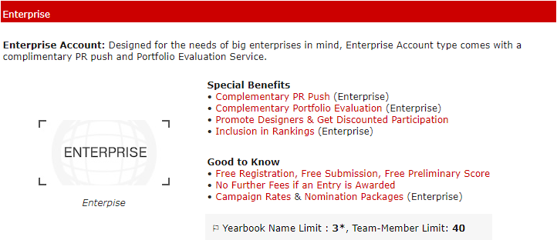
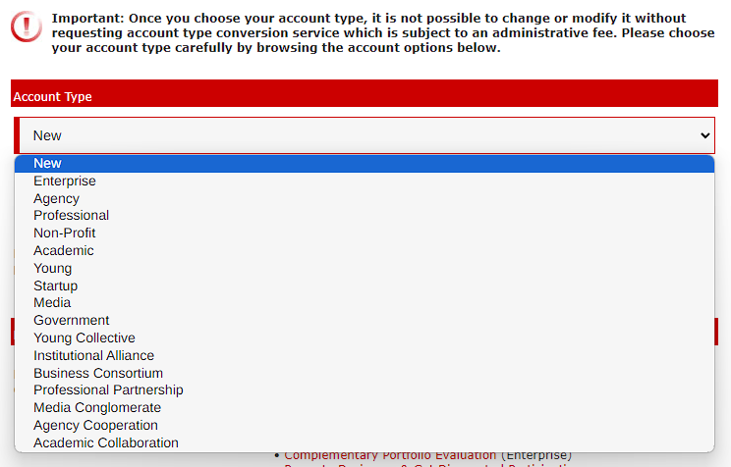
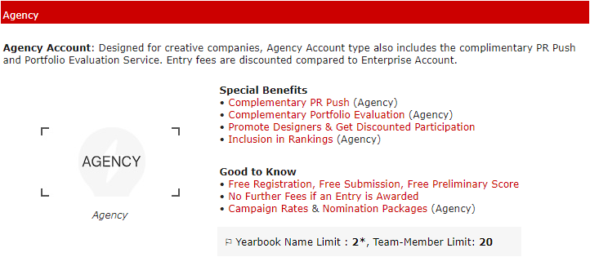
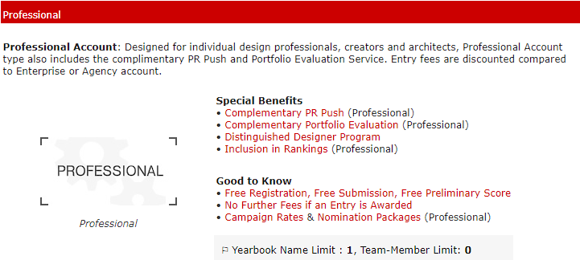
ACCOUNT TYPE
Please select the correct account type from the drop down menu.
After choosing your account type, click on SAVE ACCOUNT TYPE & CONTINUE.

Slide 9
UPLOAD YOUR DESIGN
After Account Type selection, you will be forwarded to your Control Panel. As a first time user, you will be welcomed with helpful tips to upload your first design. The Control Panel is the area where you can find all the A’ Design Award services.
PROFILE SCORE is a representation of your progress for compiling your profile. It will increase when you Update your profile.
You can download the Presentation Guidelines by clicking on the highlighted text. This would initiate a download to your personal device.
You can start uploading your design by clicking UPLOAD YOUR DESIGN

Slide 10
UPLOAD YOUR DESIGN
When you click UPLOAD YOUR DESIGN, the page you see below will be opened. This is where you prepare your DESIGN PRESENTATION. Please compile the required fields carefully. Each field has its own description to help you fill them correctly.
Please enter key details about your design. Please note that the information you entered here could appear in press releases and publications.
Please make sure you compile the fields according to the guidelines provided.
The fields should be compiled in English, using only latin alphabet.
You can use word processor software to spellcheck your texts in English before typing them here.

Slide 11
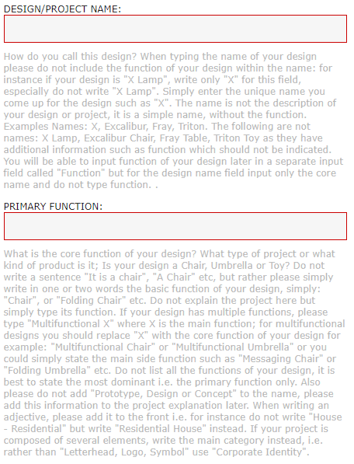
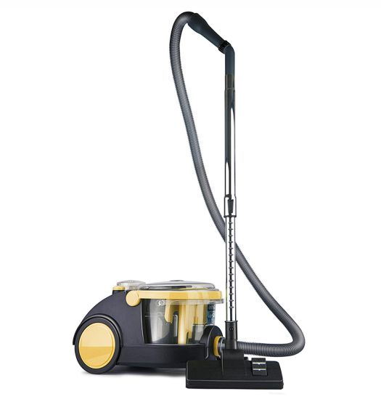
DESIGN DETAILS - REQUIRED FIELDS
REQUIRED FIELDS are obligatory for you to save your design presentation. Please follow the guidelines to compile the fields correctly.
DESIGN/PROJECT NAME:
How do you call this design? Please write only the DESIGN NAME/PROJECT NAME into this field. What your design is should be written in the PRIMARY FUNCTION field.
PRIMARY FUNCTION:
What is the core function of your design? What type of project or what kind of product is it; Is your design a Chair, Umbrella, Toy or Vacuum Cleaner?
EXAMPLE: Arnica Bora Vacuum Cleaner
DESIGN/PROJECT NAME
PRIMARY FUNCTION
Image Credits: Arnica Bora by Yasemin Ulukan

Slide 12
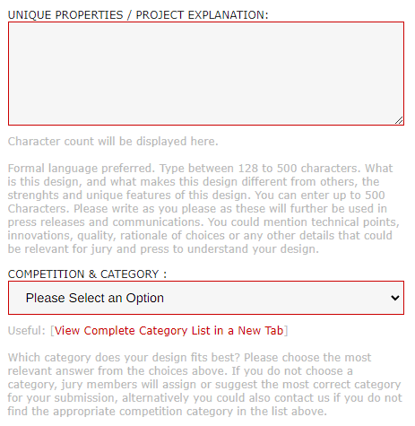
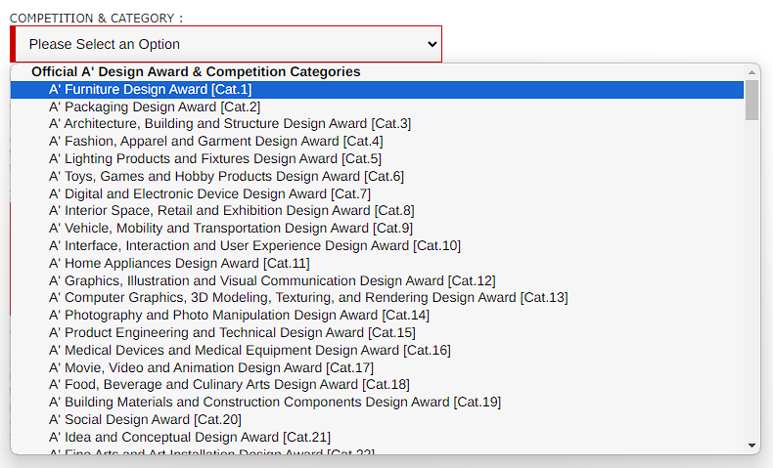
DESIGN DETAILS - REQUIRED FIELDS
Please use the UNIQUE PROPERTIES / PROJECT EXPLANATION field to explain what your design is and what makes your design different from others. Please make sure you write in formal language. After your description of the project, please make sure you select the correct Competition & Category for your design.
Please select your category from the drop down menu.

Slide 13
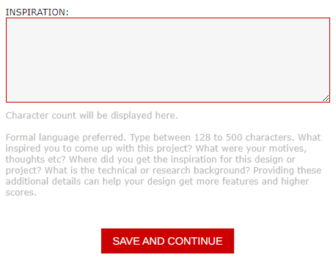
DESIGN DETAILS - REQUIRED FIELDS
INSPIRATION field is the last REQUIRED FIELD. The rest of the text fields are optional but highly suggested as the additional information you provide will improve how you communicate your design with the jury members. The image upload will be at the next stage so please make sure you follow through with the whole upload process.
INSPIRATION:
This is where you will explain your motives for your design/project. Where did you get the inspiration for this design or project?
You can click SAVE AND CONTINUE to proceed with the Image Upload. If you wish to fill the Optional Fields, make sure you scroll down and fill them before you click SAVE AND CONTINUE.

Slide 14
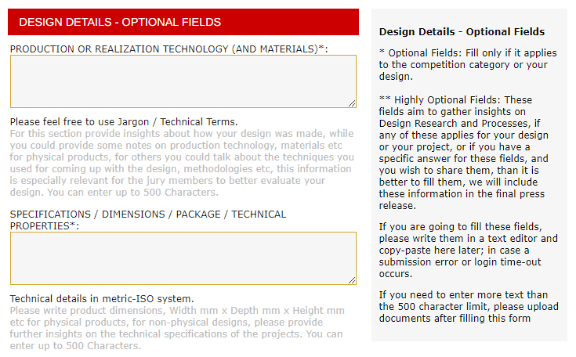
DESIGN DETAILS - OPTIONAL FIELDS
This section is dedicated to any additional information you may want to provide to improve your presentation. After you fill in the fields relevant to your entry, scroll down until you see a red box with the text SAVE AND CONTINUE, and click on it to proceed to the Image Upload page.

Slide 15
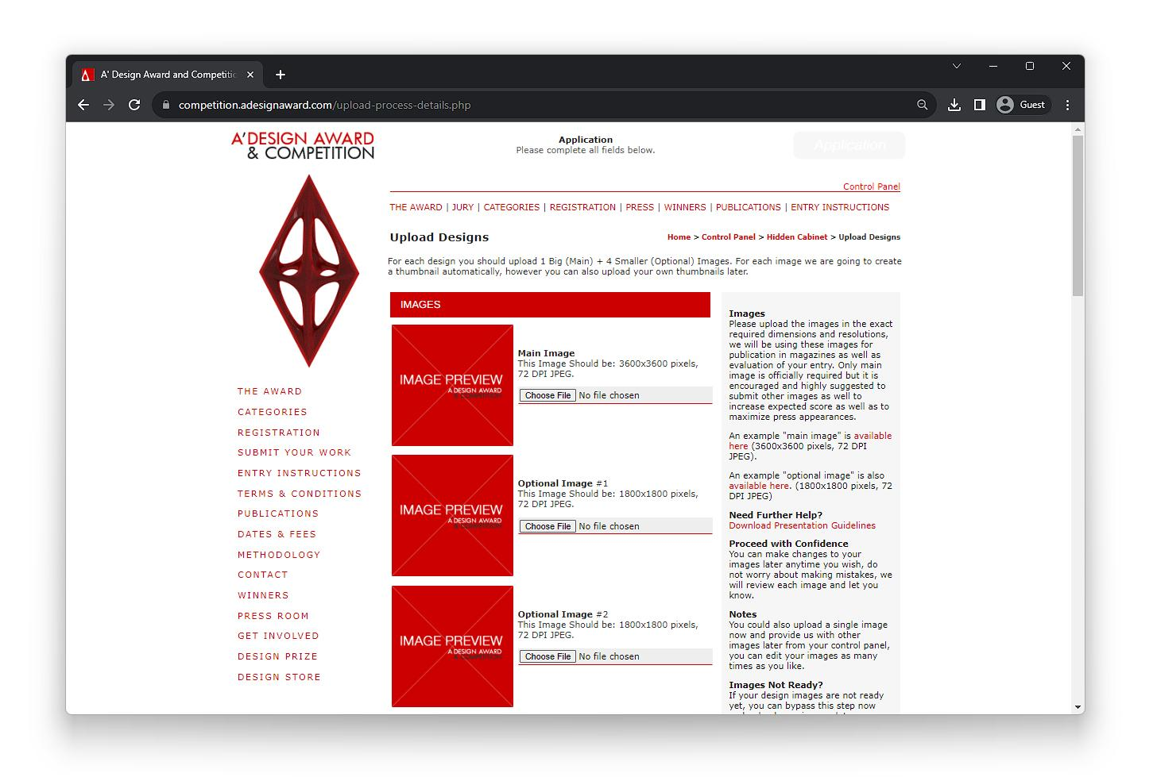
IMAGES
IMAGES page is where you will be uploading the images for your presentation. You should upload 1 Big (Main) + 4 Smaller (Optional) Images. When you are uploading your images, please make sure your images have the correct dimensions and format.
MAIN IMAGE:
This Image Should be: 3600 x 3600 pixels, 72 DPI JPEG.
Make sure your images are RGB.
OPTIONAL IMAGES:
This Image Should be: 1800 x 1800 pixels, 72 DPI JPEG.
Make sure your images are RGB.

Slide 16
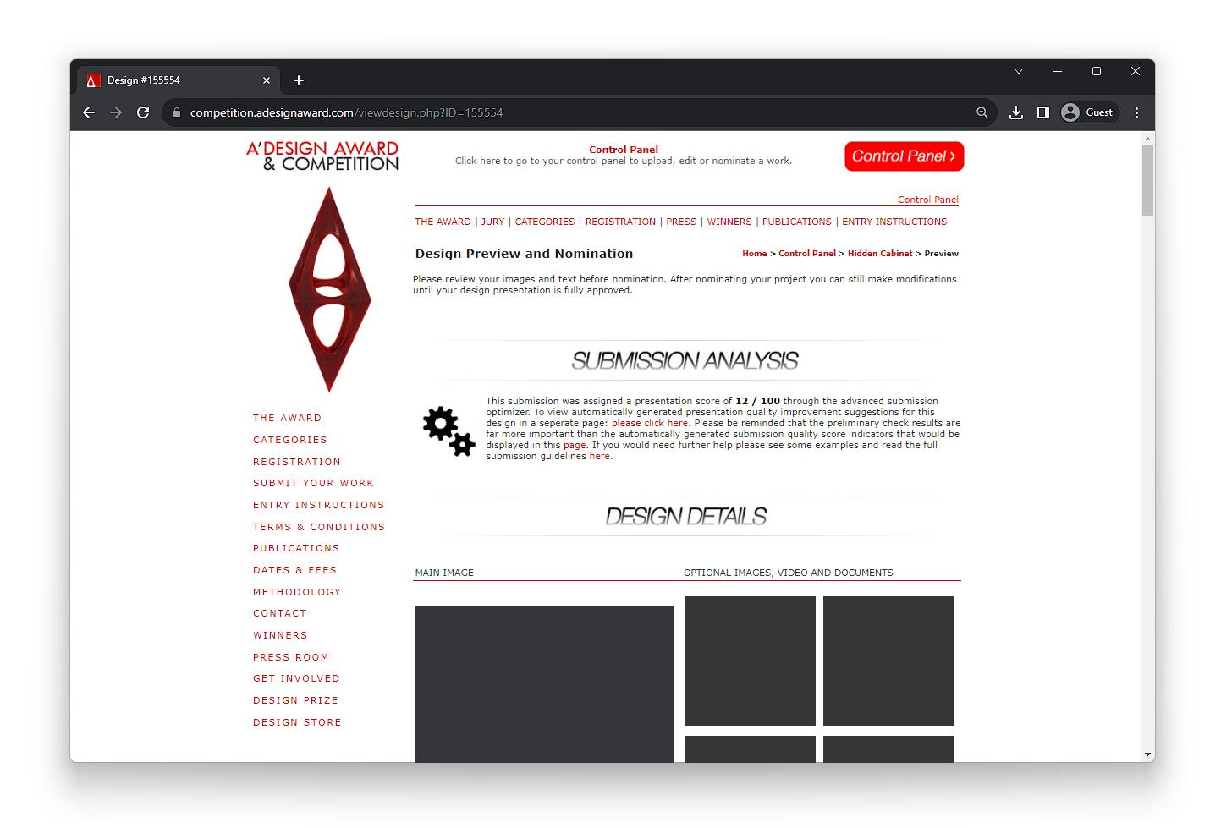
DESIGN PREVIEW AND NOMINATION
After you upload your images, you will be forwarded to your presentation so you can review it. Below is a sample page. You will have your unique presentation and your own unique design ID.
Your unique DESIGN ID will be shown here. Please keep in mind that Profile ID and Design ID are not the same thing.
Your presentation score calculated by advanced submission optimizer. You can improve this score by following the improvement suggestions.

Slide 17
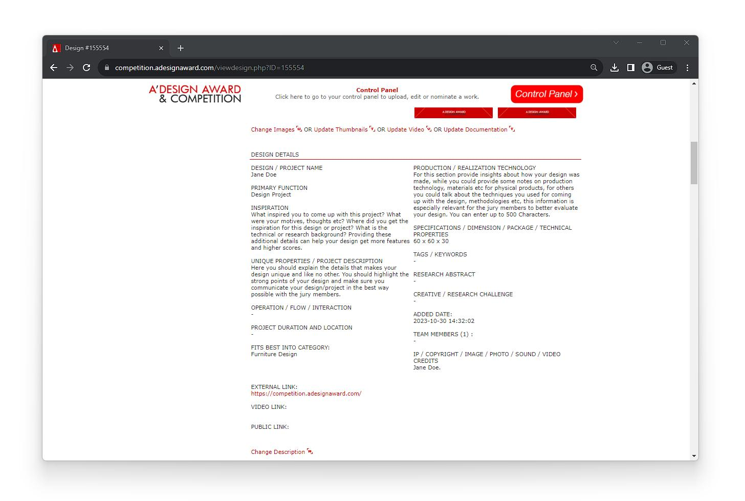
DESIGN PREVIEW AND NOMINATION
If you wish to make changes to your presentation, you are allowed to do it until the deadline period. You can click on CHANGE IMAGES to update your existing images, and you can click on CHANGE DESCRIPTION to modify your description.
CHANGE IMAGE button is located right under the images of your entry. You can update your images by clicking on the text CHANGE IMAGE.
CHANGE DESCRIPTION is at the bottom of the DESIGN DETAILS section. You can update your description by clicking on the text CHANGE DESCRIPTION.

Slide 18
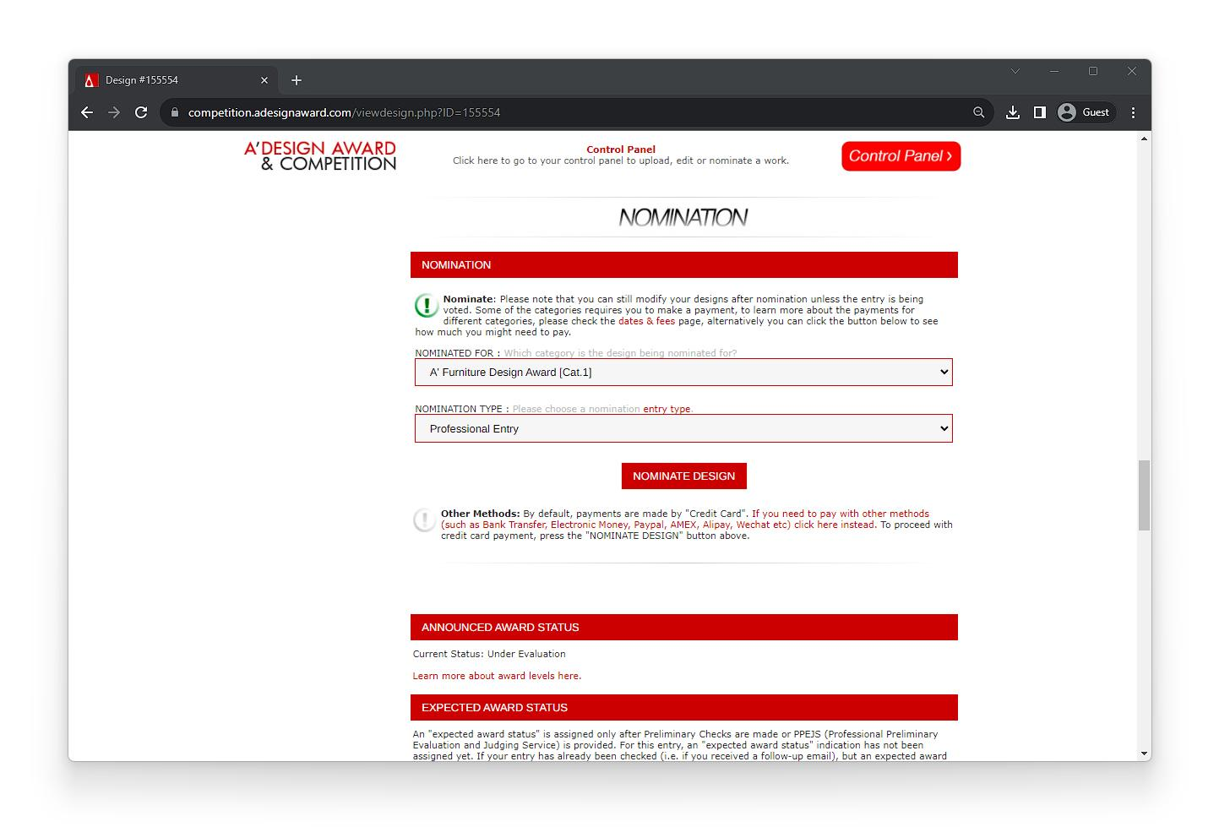
DESIGN PREVIEW AND NOMINATION
If you wish to NOMINATE your entry, you can scroll down on your DESIGN PREVIEW page and proceed with the NOMINATIOn by clicking NOMINATE DESIGN. You will be forwarded to the PAYMENT screen once you click on NOMINATE DESIGN.

Slide 19
WHERE IS YOUR DESIGN?
If you wish to see / update your uploaded designs, you need to find MY DESIGNS section in your Control Panel. When you click on MY DESIGNS, your Hidden Cabinet will open where you can see your designs all at once.
Click on the red text that says MY DESIGNS to reach your Hidden Cabinet where all the designs you uploaded to the system are listed.

Slide 20
WHERE IS YOUR DESIGN?
Once you click on MY DESIGNS, your Hidden Cabinet (Uploaded Designs) page will open. Make sure your filter is set to ALL ENTRIES to see all of your uploaded designs.
Make sure your current filter is set to ALL ENTRIES to see all of your uploaded designs.
Your unique DESIGN ID and PROJECT NAME will be listed here. You can click on the ID to preview your entry.

Slide 21
USEFUL LINKS
ENTRY INSTRUCTIONS: https://competition.adesignaward.com/entryinstructions.html
ACCOUNT TYPES: https://competition.adesignaward.com/account-types.php
CATEGORIES: https://competition.adesignaward.com/categories.html
YOUR DESIGNS: https://competition.adesignaward.com/hiddencabinet.php
AWARD WINNING DESIGNS: https://competition.adesignaward.com/winners.php

